Slide 1

See full manual at https://btt-writer.readthedocs.io/en/latest/
Using BTT Writer

Slide 2
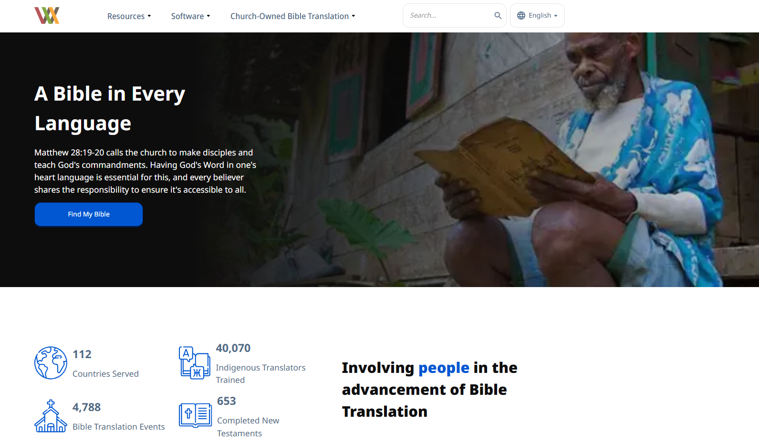
Downloading and Installing
bibleineverylanguage.org
Click “Resources”

Slide 3
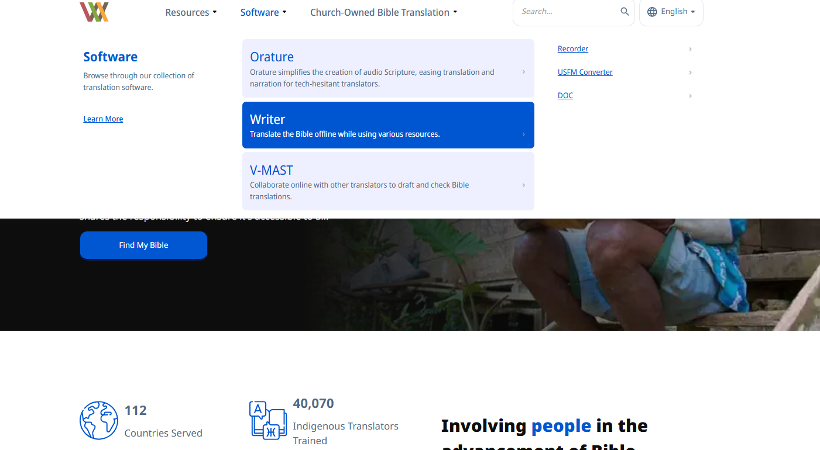
Click “Writer”

Slide 4
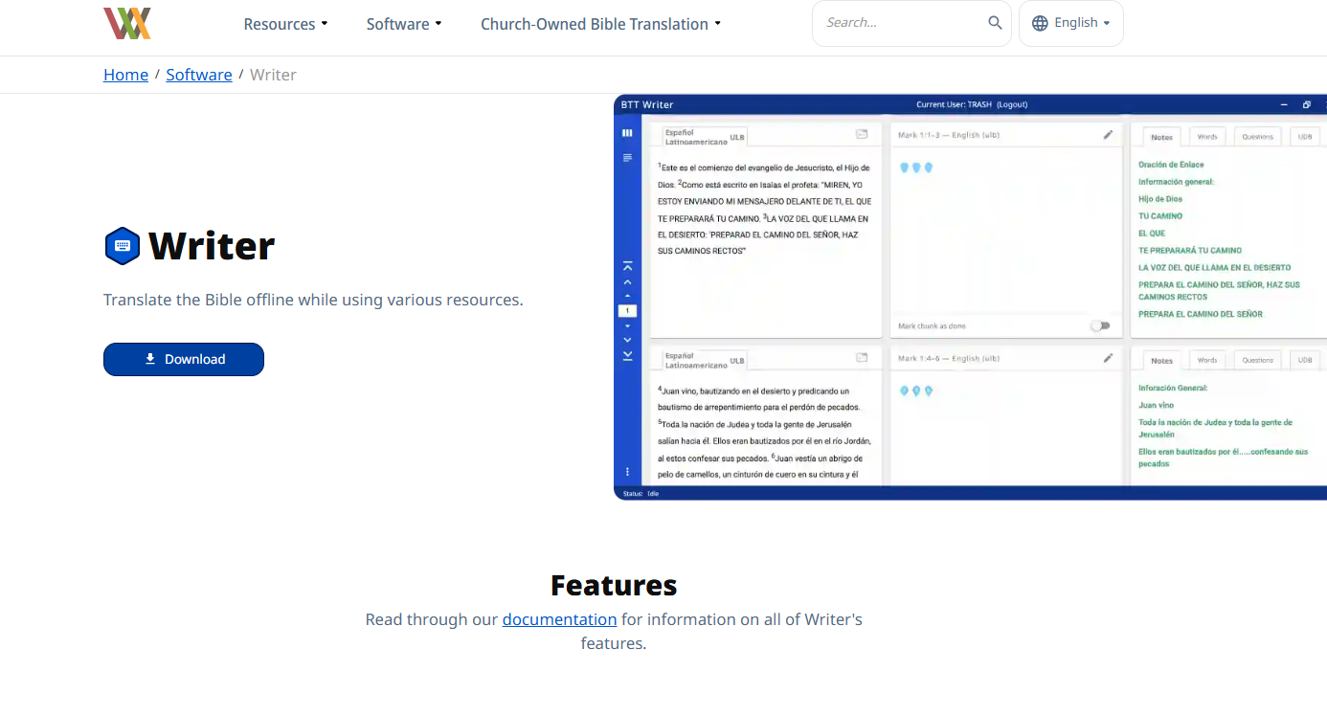
Click “Download”

Slide 5
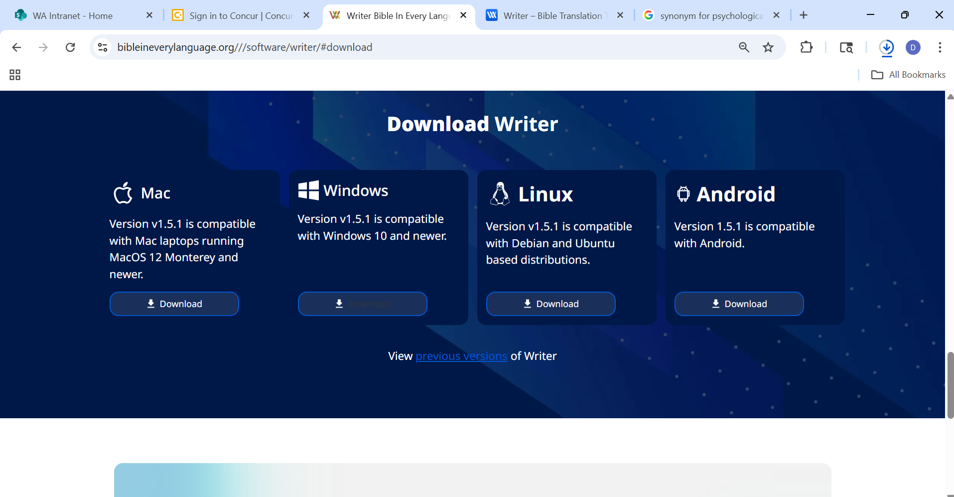
Select your operating system

Slide 6
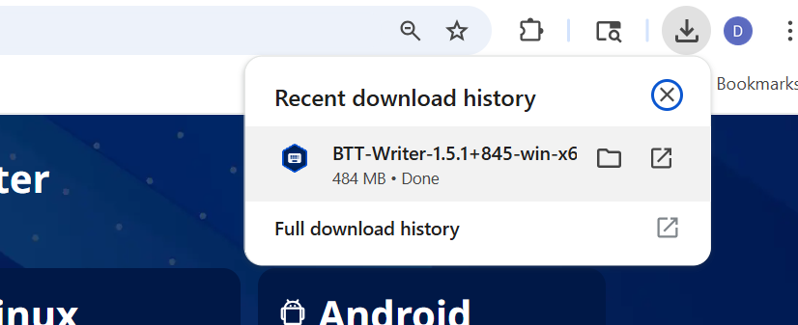
Wait for the download. Then click the “Downloads” icon.
Click “Open” or “Run”

Slide 7
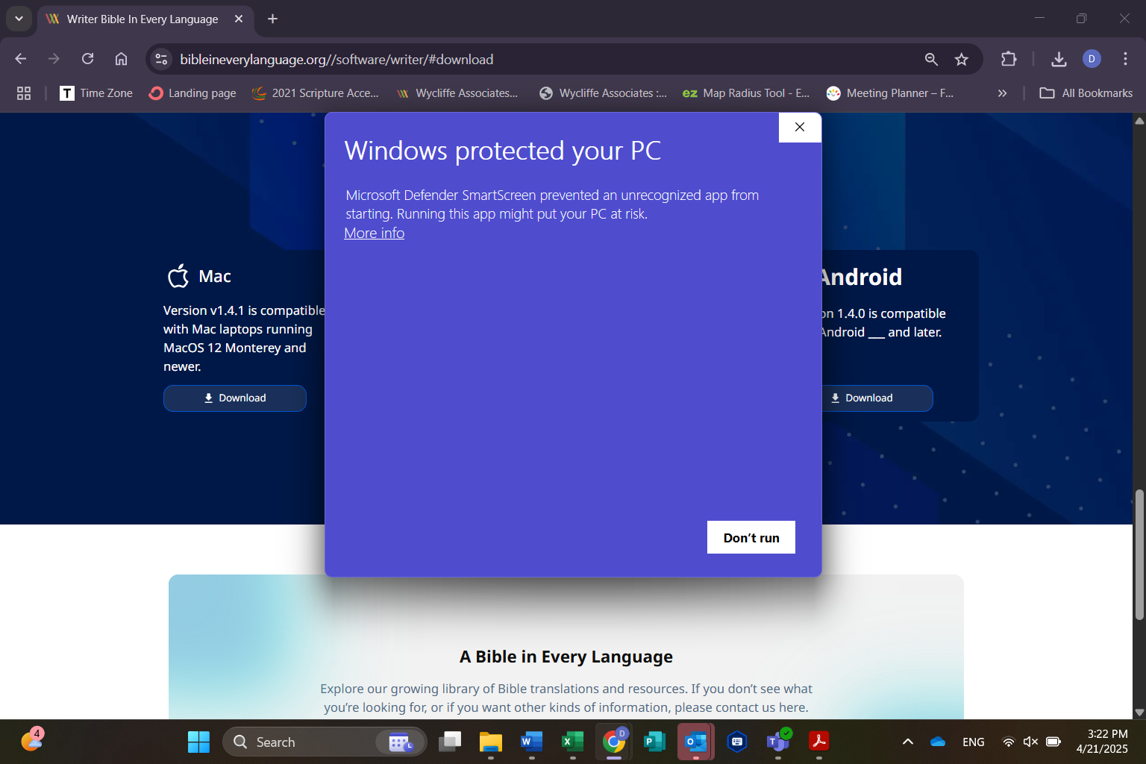
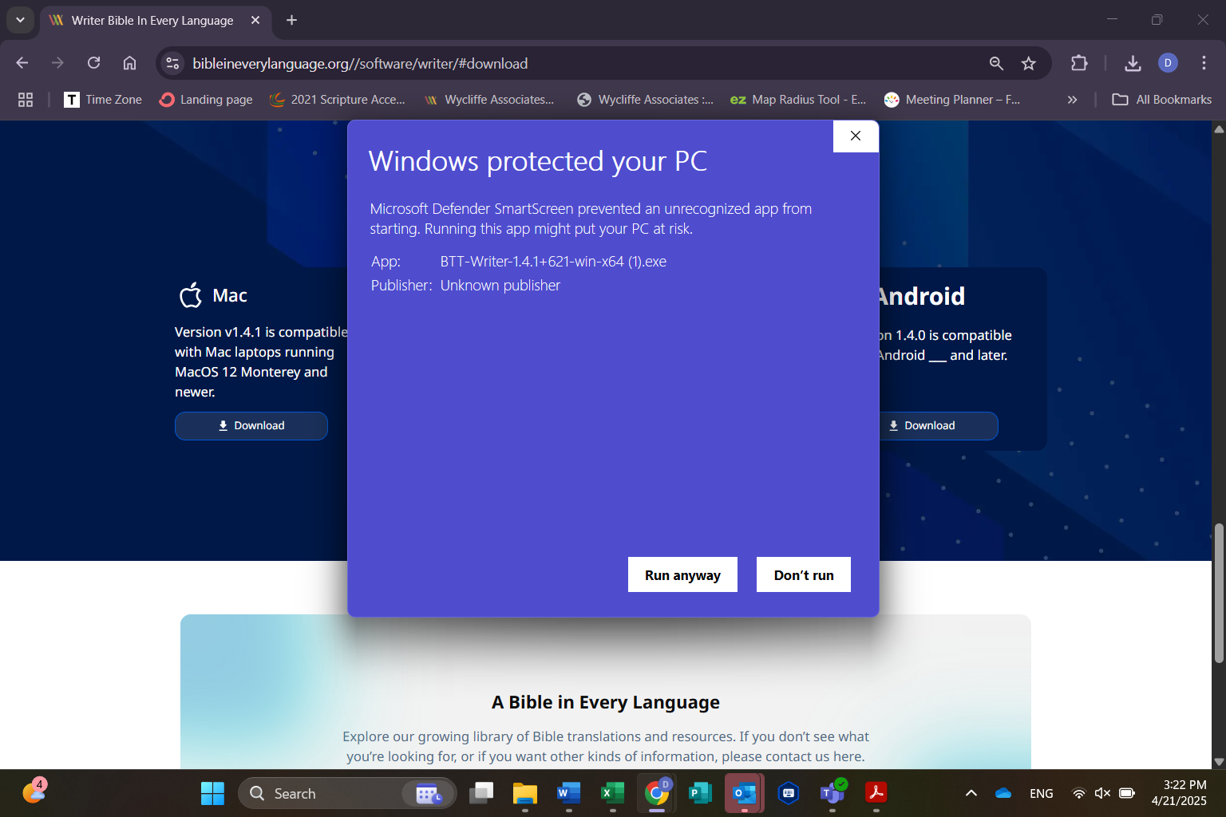
If your device blocks installation, click “More info”
Give permission by clicking “Run anyway”

Slide 8
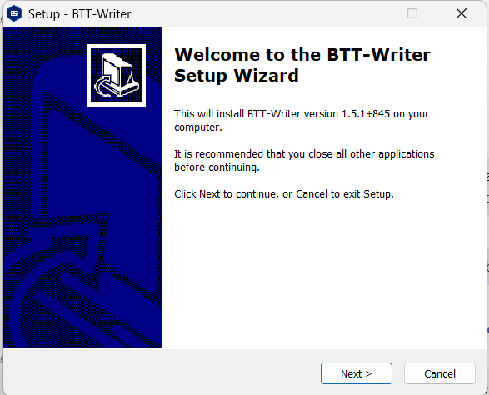
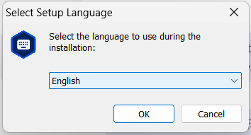
Click “Next”
Select your desired language for installation messages and click “OK”
Select your desired language for installation messages. Then click “OK”

Slide 9
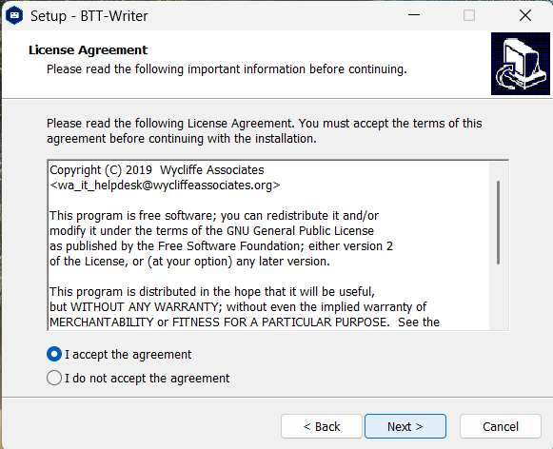
Accept the terms and click “Next”

Slide 10
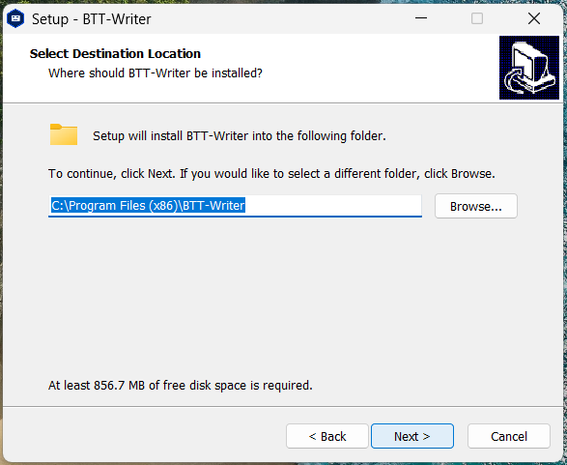
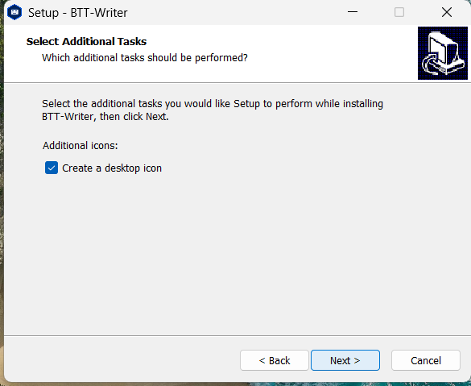
Approve file location by clicking “Next”
We recommend creating a desktop icon. Then click “Next”

Slide 11
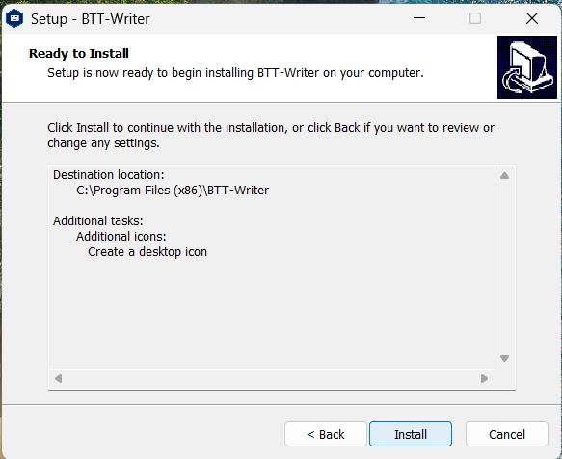
Click “Install”

Slide 12
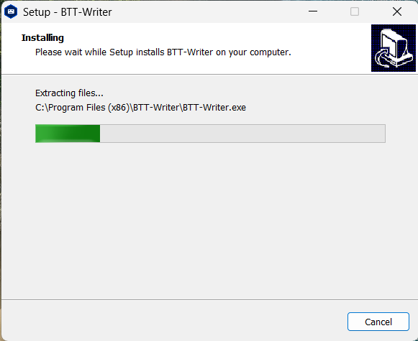
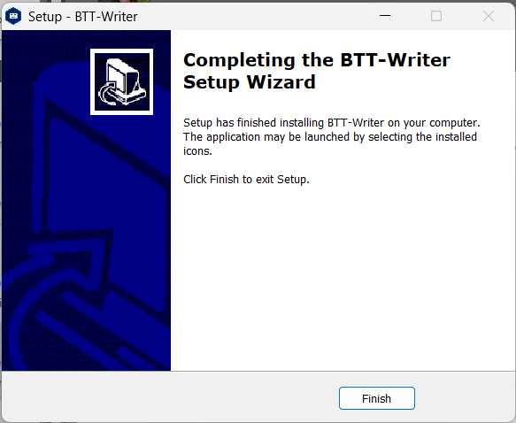
Click “Finish”

Slide 13
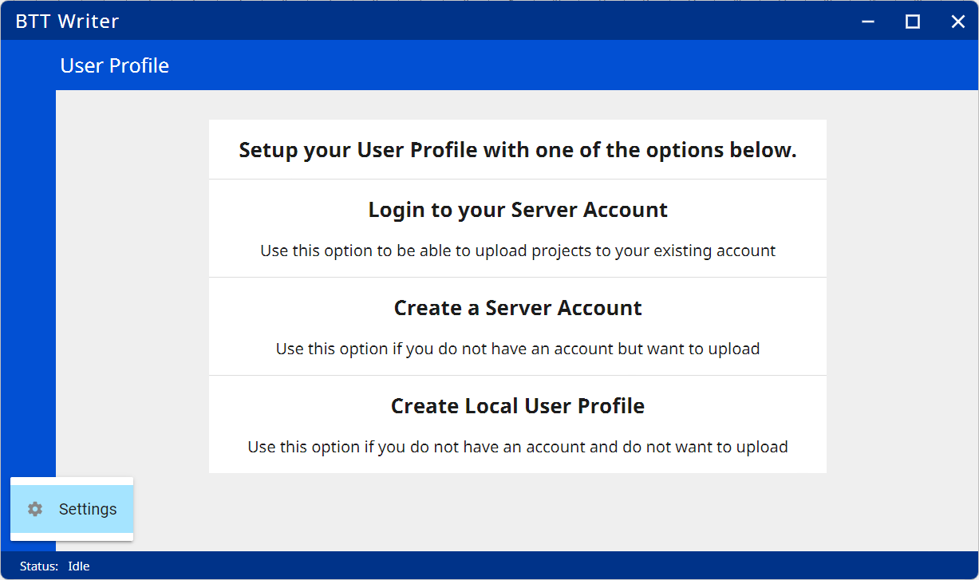
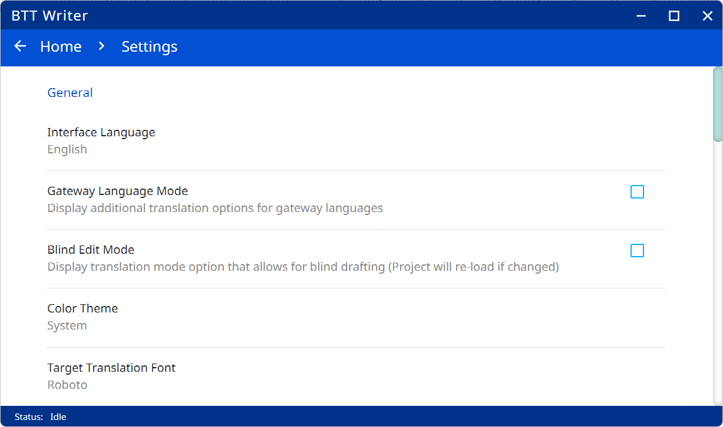
Click on "Interface Language“ to change the desired language
Click on the three dots, then "Settings"

Slide 14
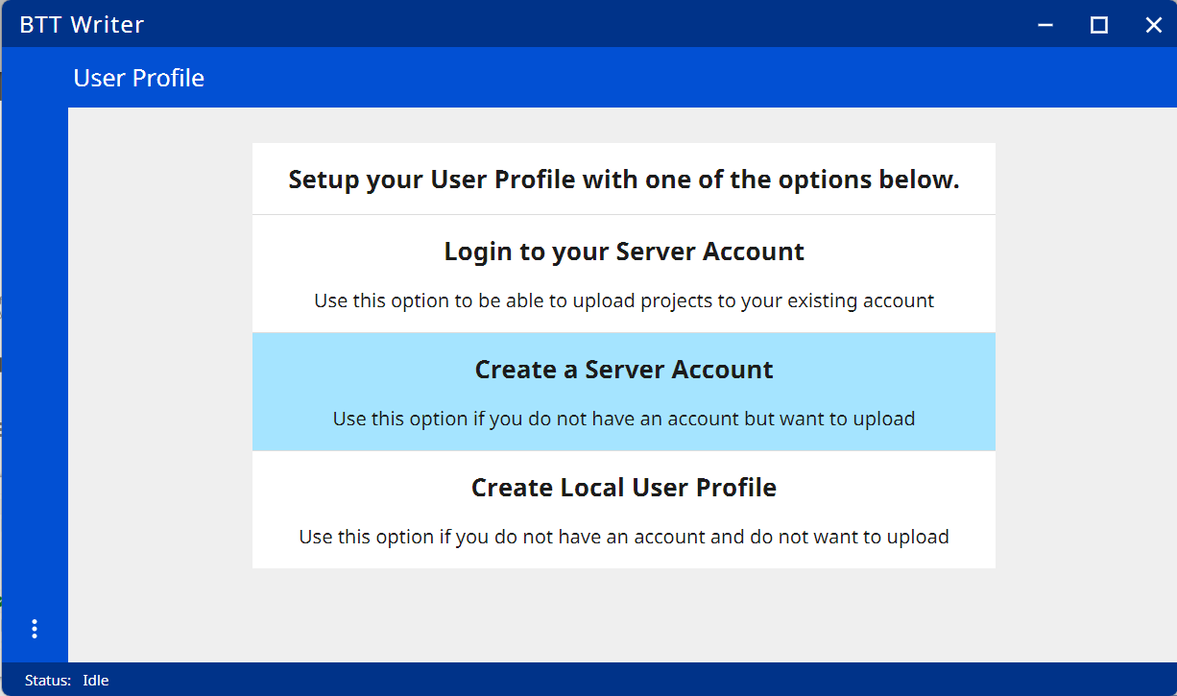
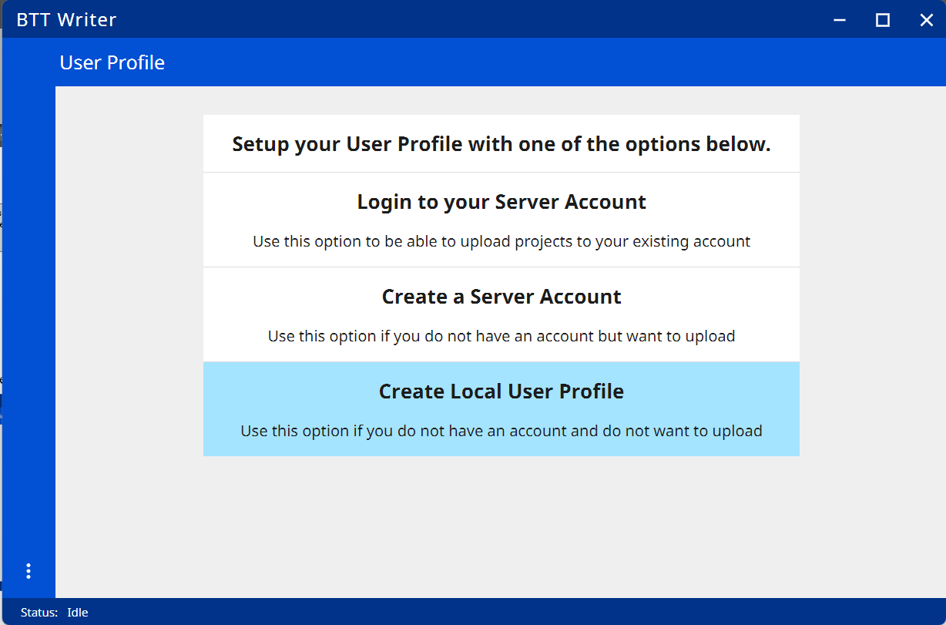
Account Setup
On your first access, you need to create an account: either a Server Account (for uploading) or a Local User Profile (for storage on the computer only)
On your first access, you need to create an account: either a Server Account (for uploading) or a Local User Profile (for storage on the computer only)

Slide 15
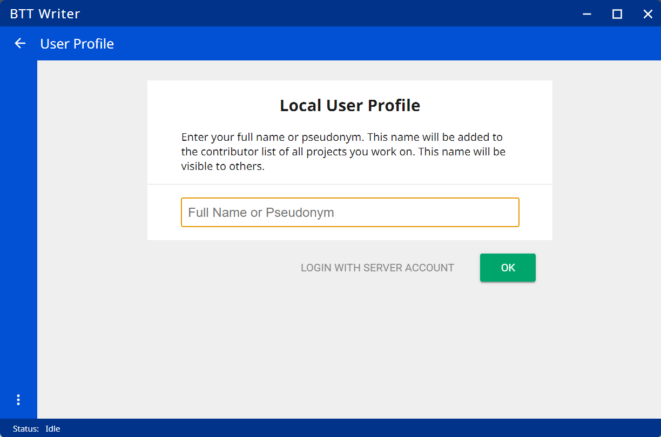
Local User Profile
Click to enter your desired name.

Slide 16
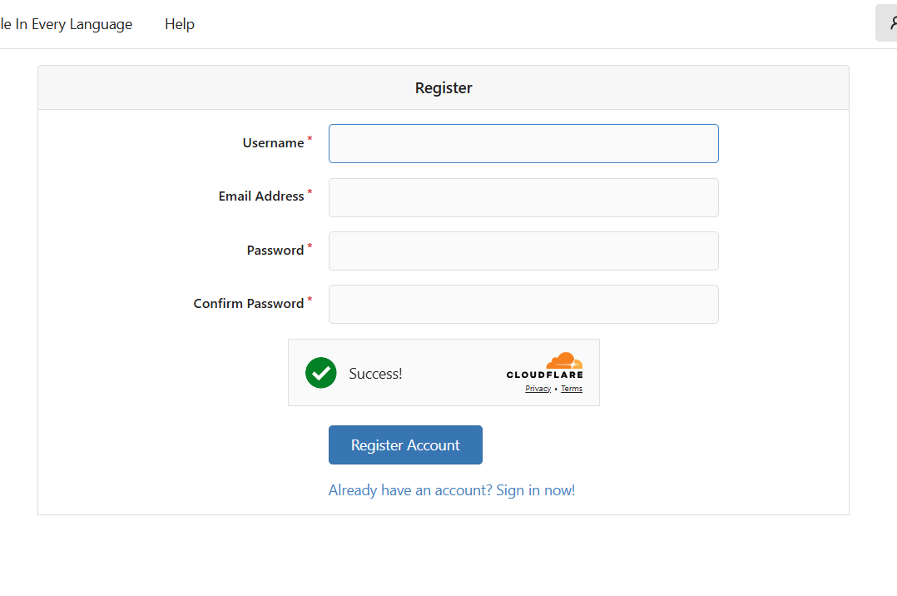
Server Account: You must remember your Username and password.
Choose any “Username” and provide your email address.
Add your password, and re-type it to confirm it.
Click the link in your email to confirm your email address and activate your account.

Slide 17
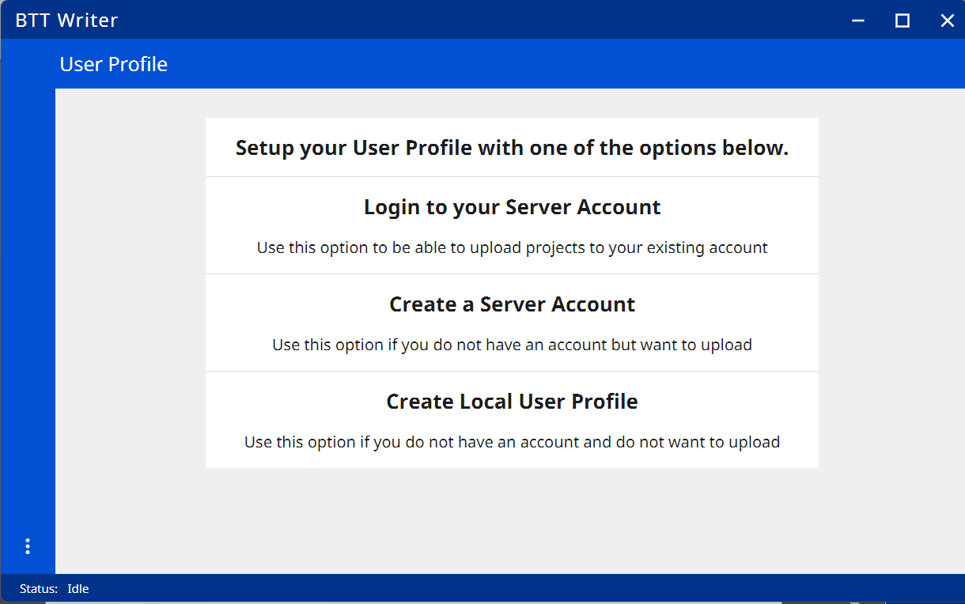
Logging In
Now you can log in to your account.

Slide 18
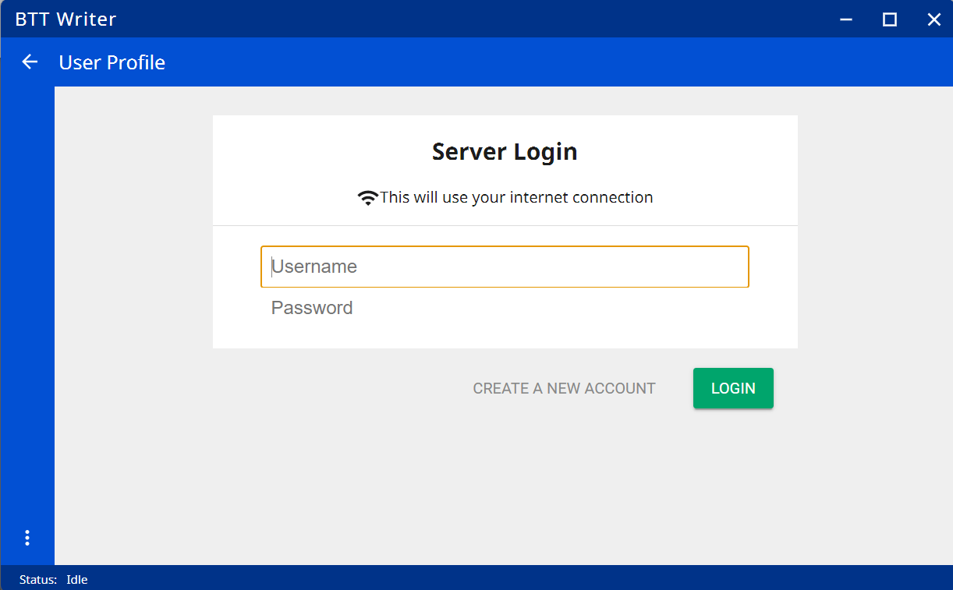
Type your Username and password. Click “Login”
Type your Username and password. Click “Login”
Type your Username and password. Click “Login”

Slide 19
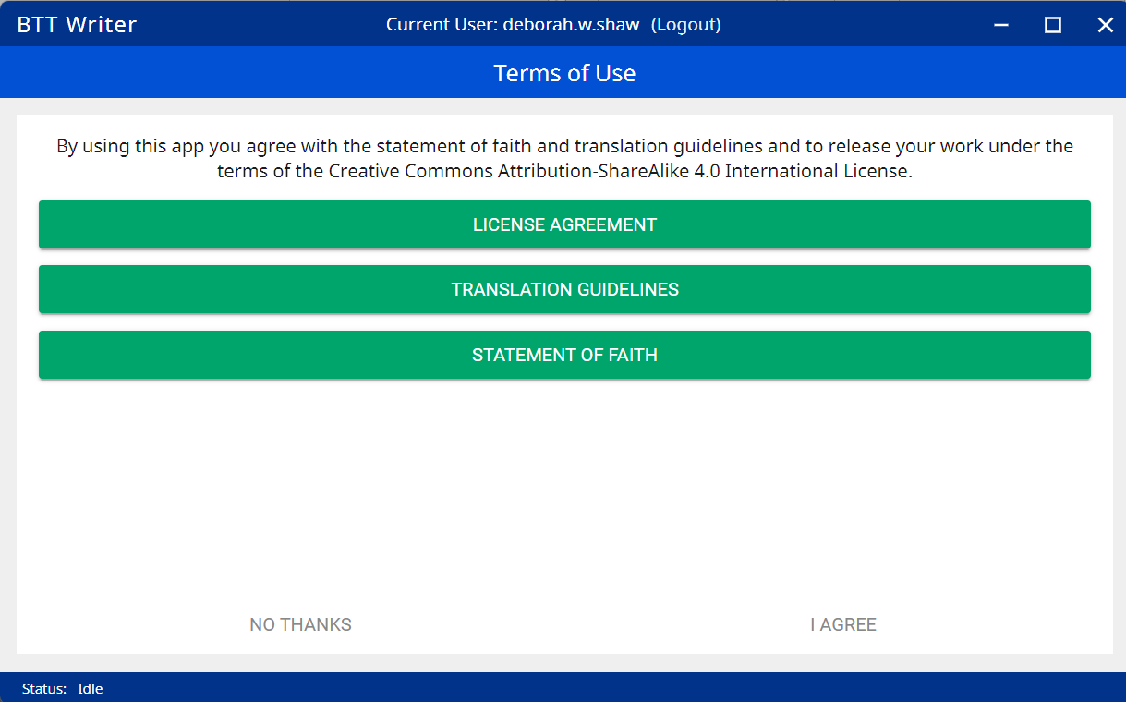
Click each statement to read the agreement.
Click each statement to read the agreement.
Click each statement to read the agreement.
If you agree, click “I Agree”

Slide 20
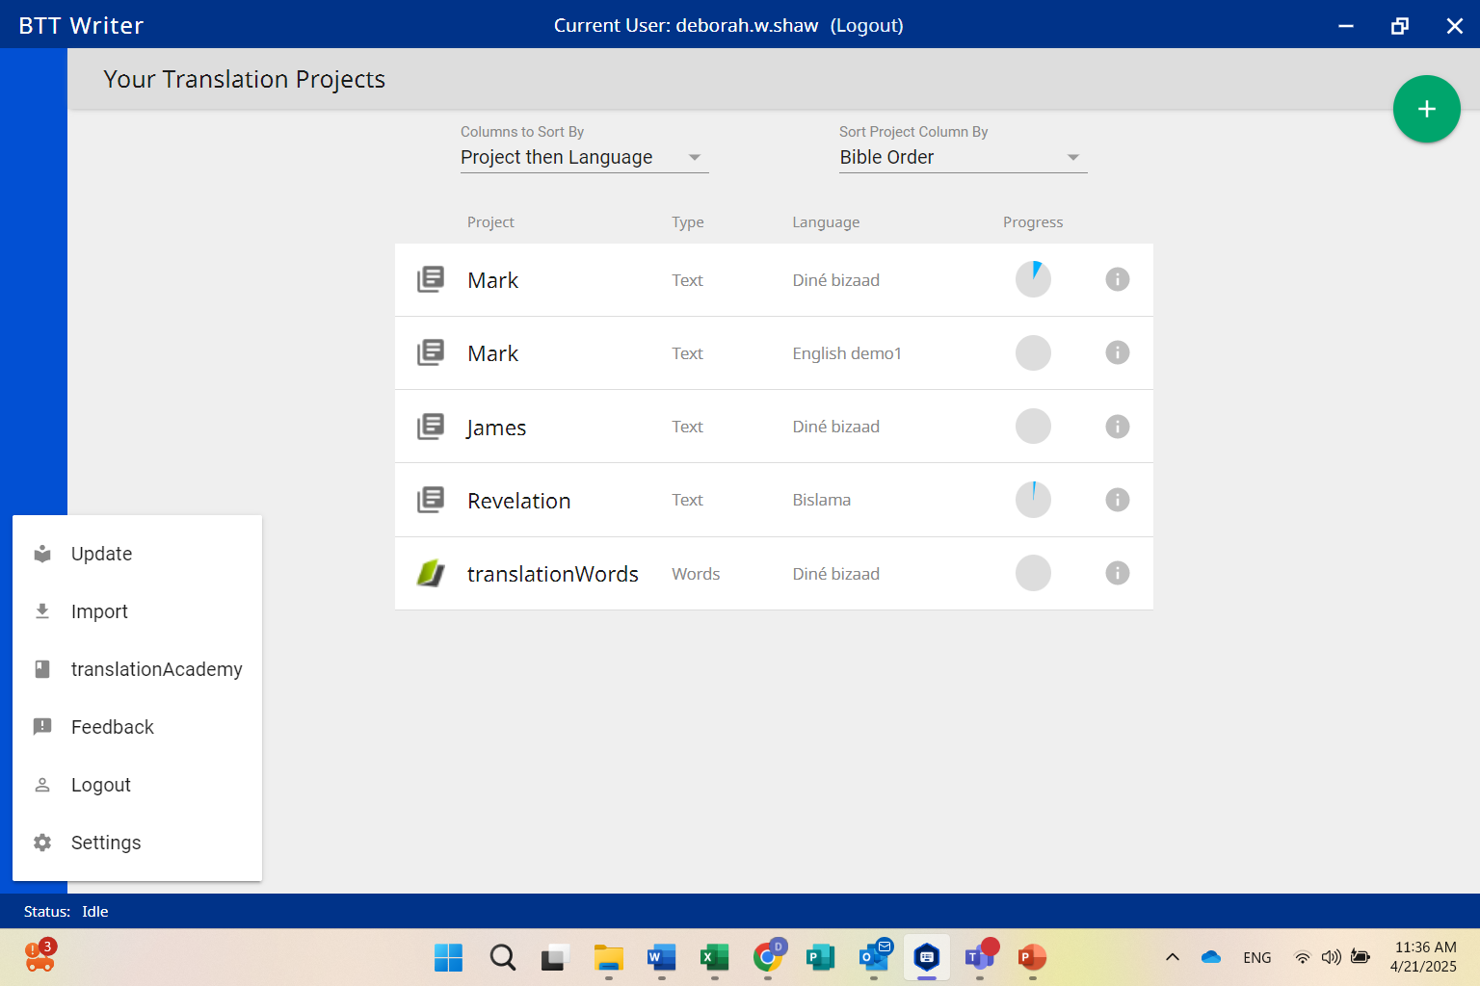
Home Screen (Welcome message shows if there are no projects)
Click the menu (three dots). Select “Settings”

Slide 21
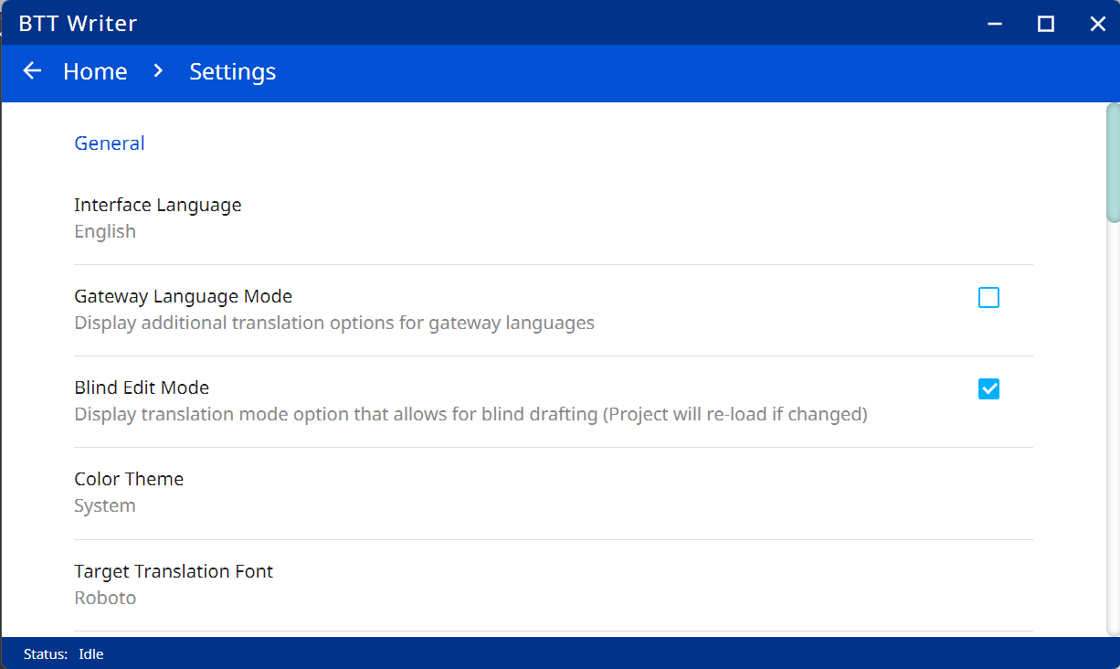
Enabling Blind Edit Mode
Click to enable “Blind Edit Mode”

Slide 22
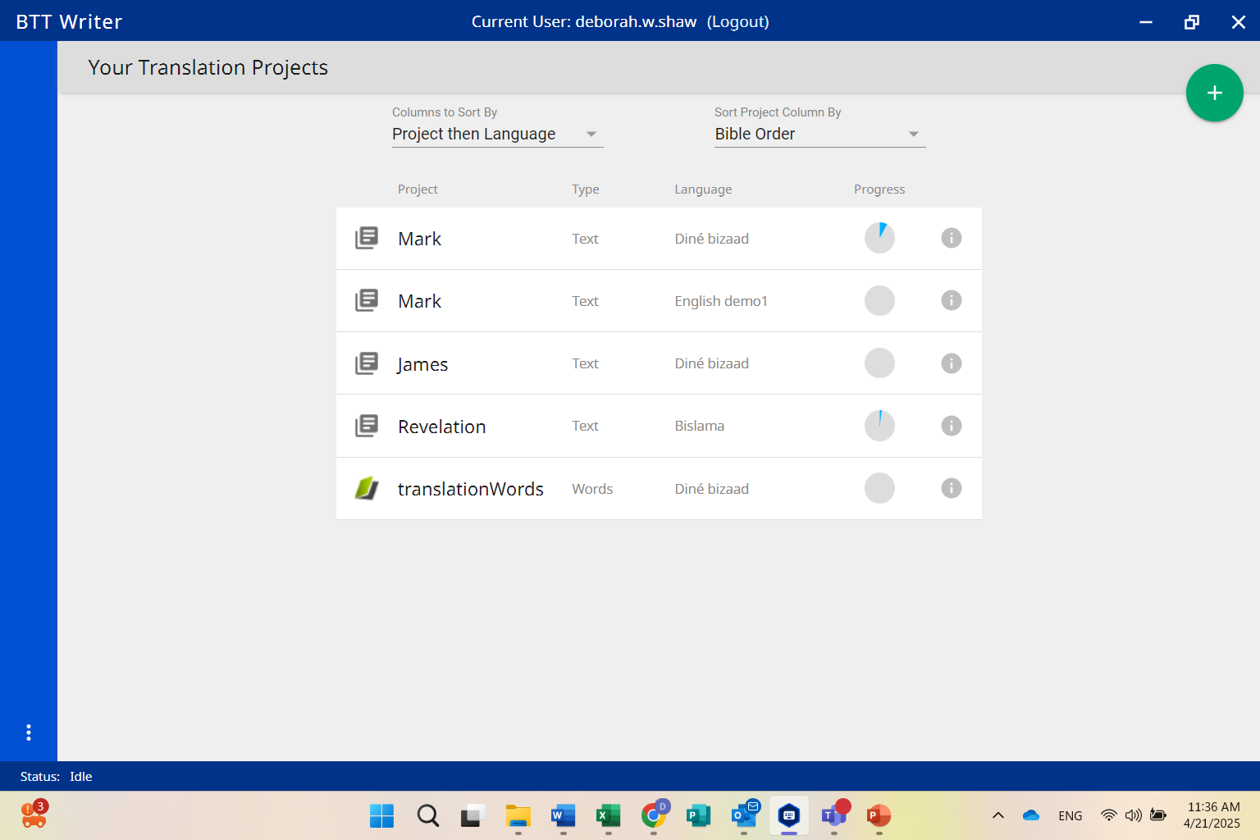
Starting a New Project
Start a New Project

Slide 23
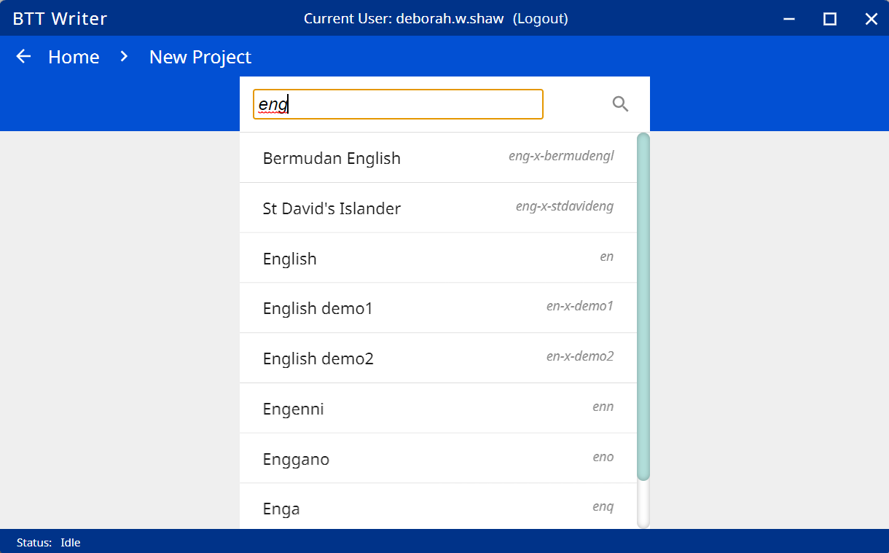
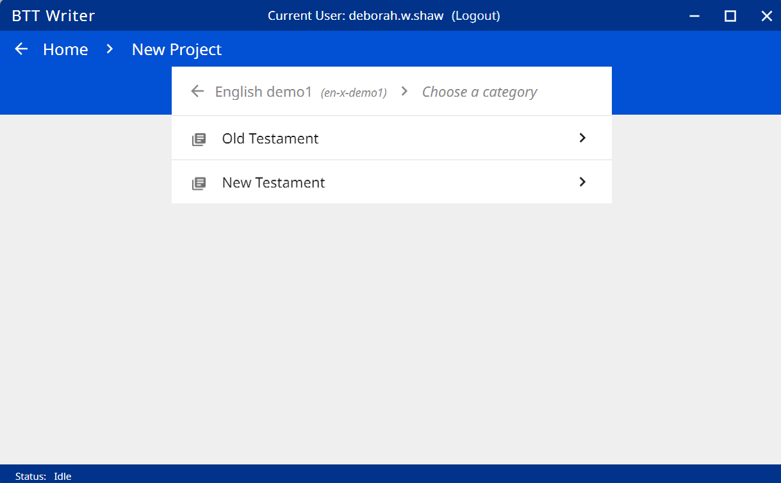
Search and select the language of the translation
Select the testament for the book you will be translating

Slide 24
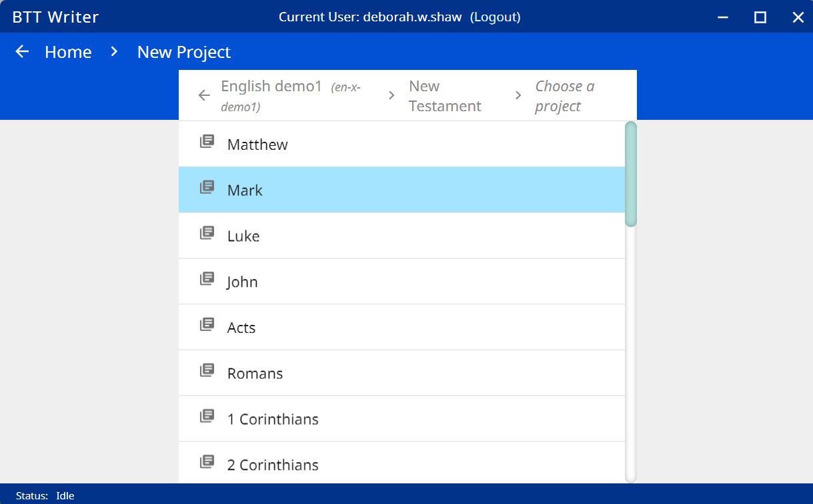
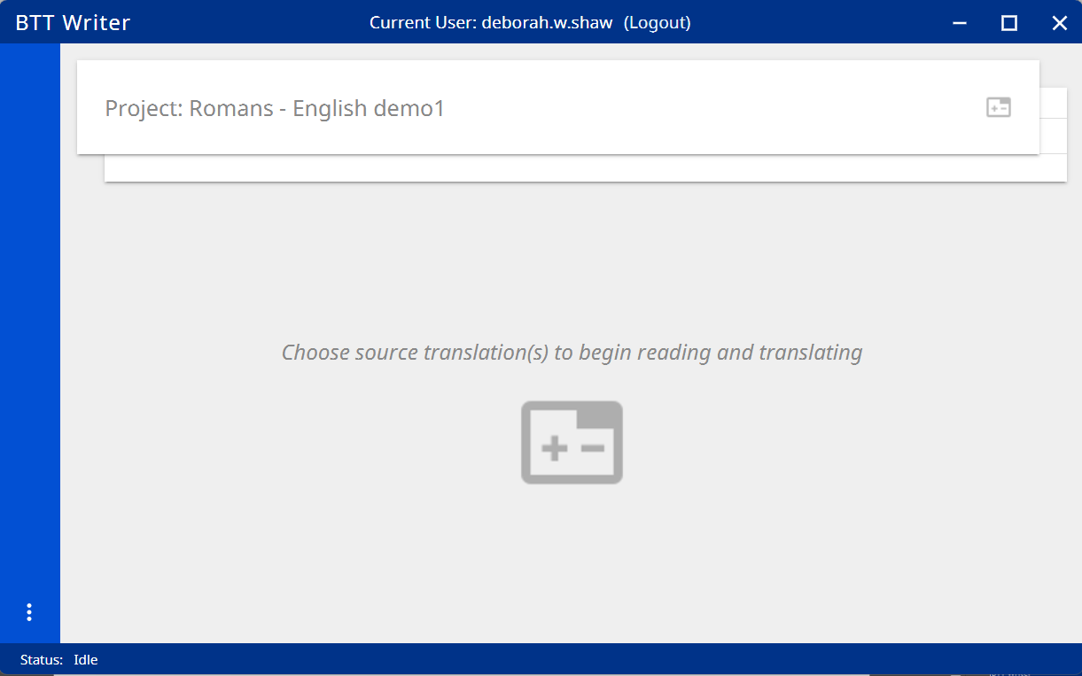
Select the book you will be translating
Select the book you will be translating
Click either icon to select the source text.

Slide 25
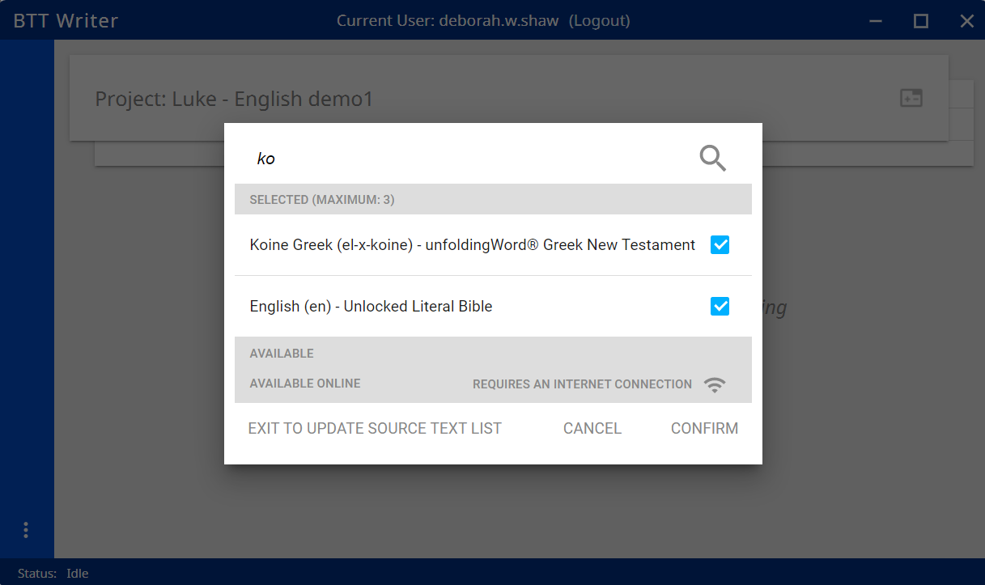
Search for the source language and select the checkbox, then click "Confirm"

Slide 26
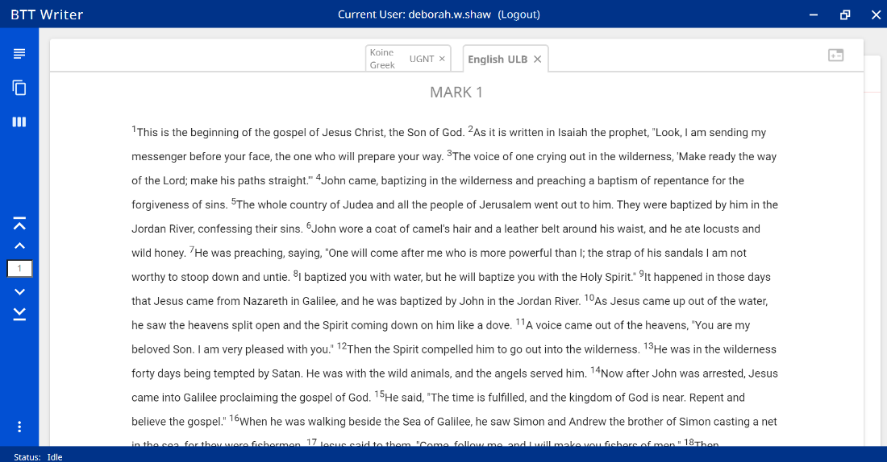
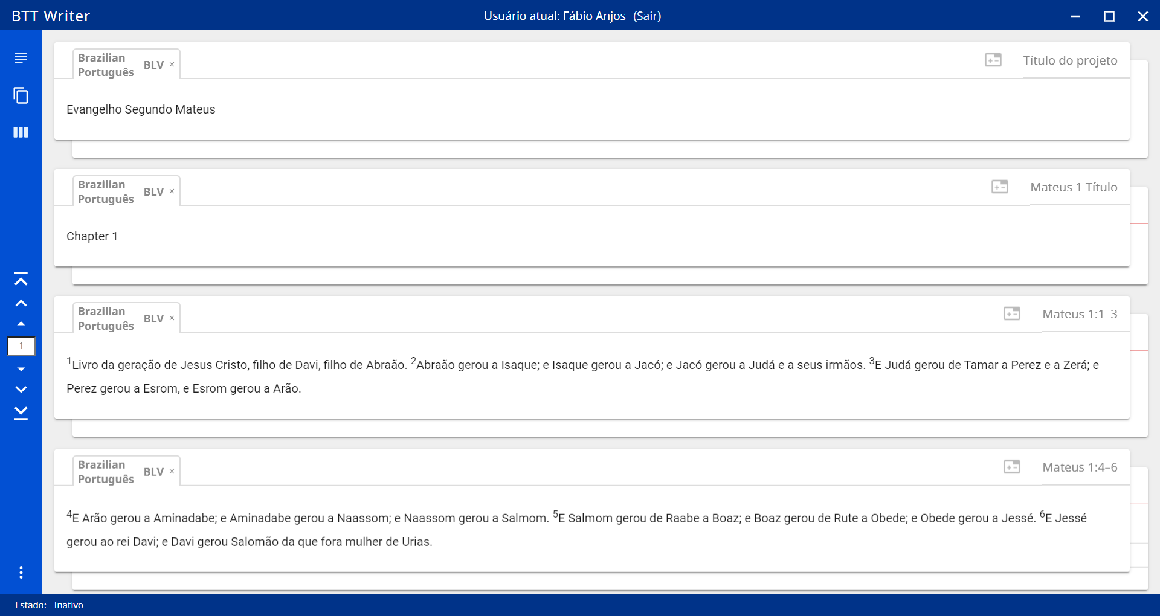
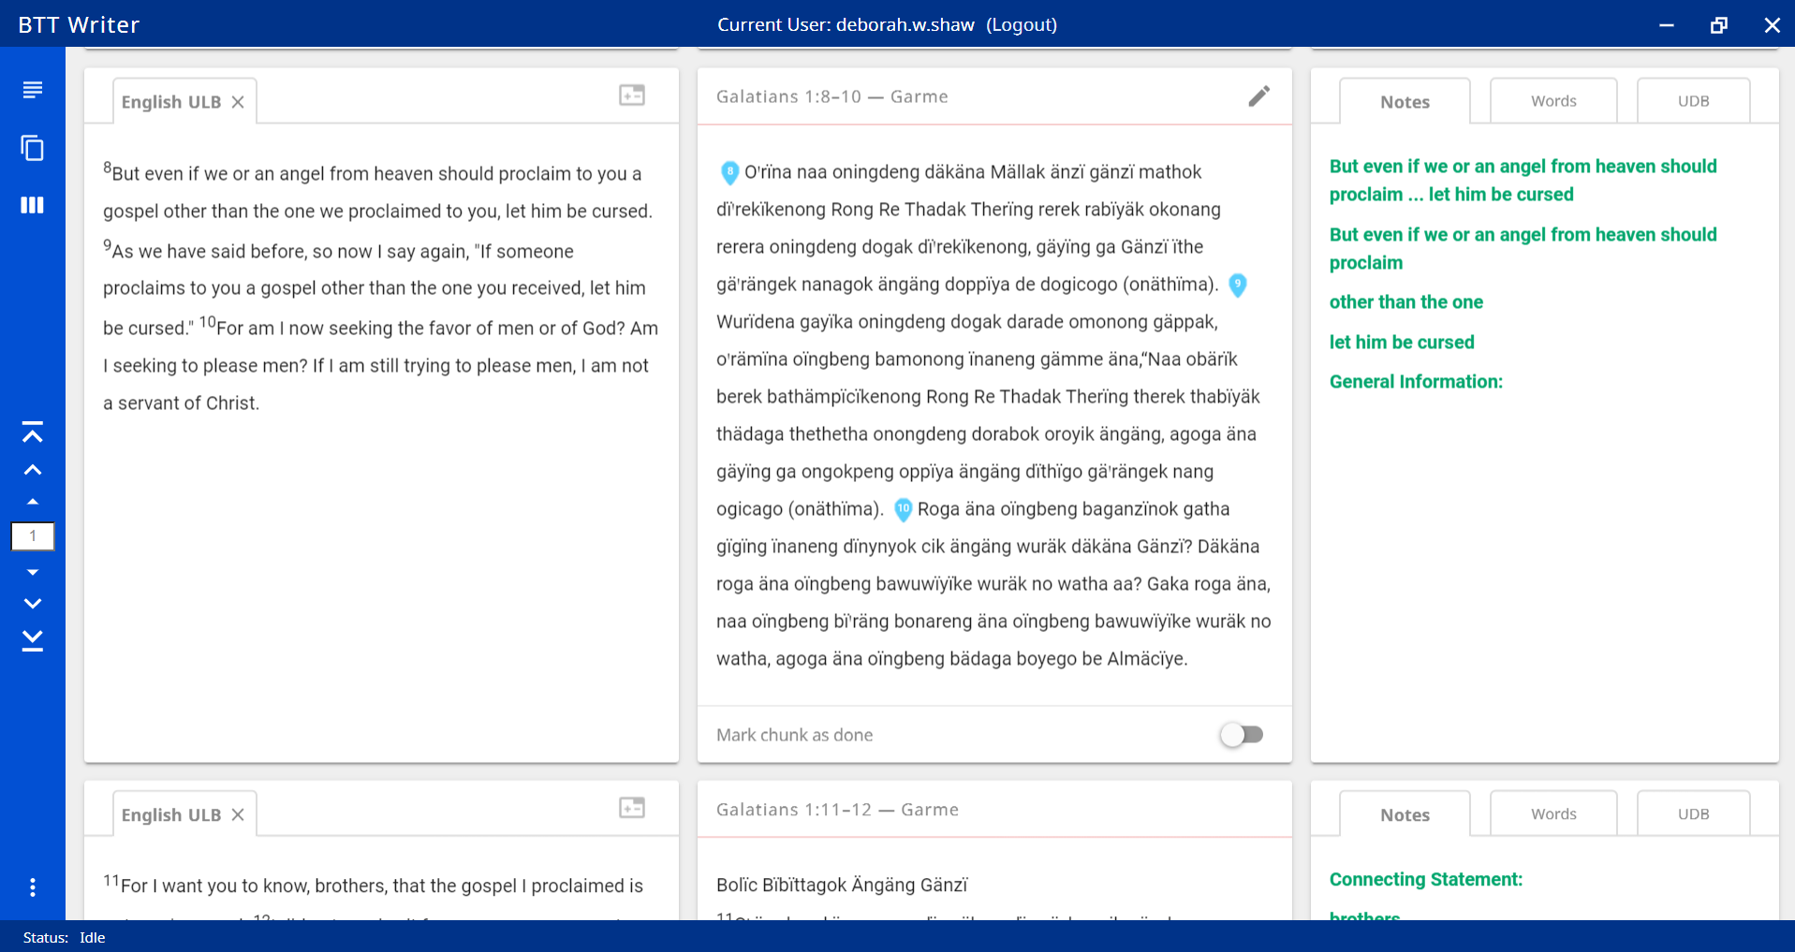
Three Views
Read view: Use for Step 1: Consume
Blind Edit view: Use for Step 4: Blind Draft
Edit-Review view: Use for checking steps

Slide 27
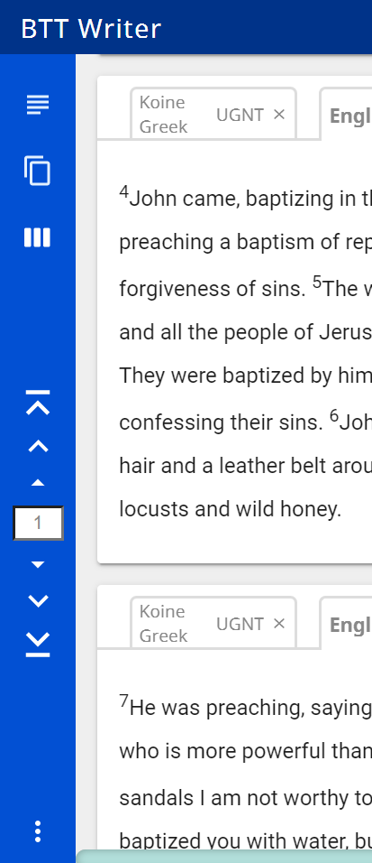
Navigating
Type number and press “Enter” key on keyboard to skip to that chapter
Smallest arrows navigate to previous or next chunk
Middle arrows navigate to previous or next chapter
Large arrows navigate to beginning or end of book

Slide 28
Translating Within a Project
Consume: Read view
Verbalize: no text should be used
Chunk: make notes on paper while looking at Read view
Blind Draft: Blind Edit view
Self Check: Edit-Review view

Slide 29
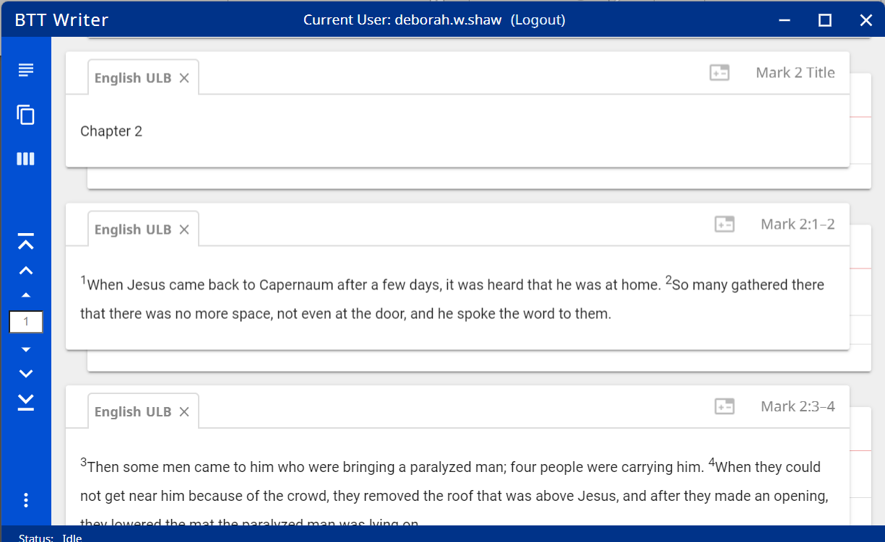
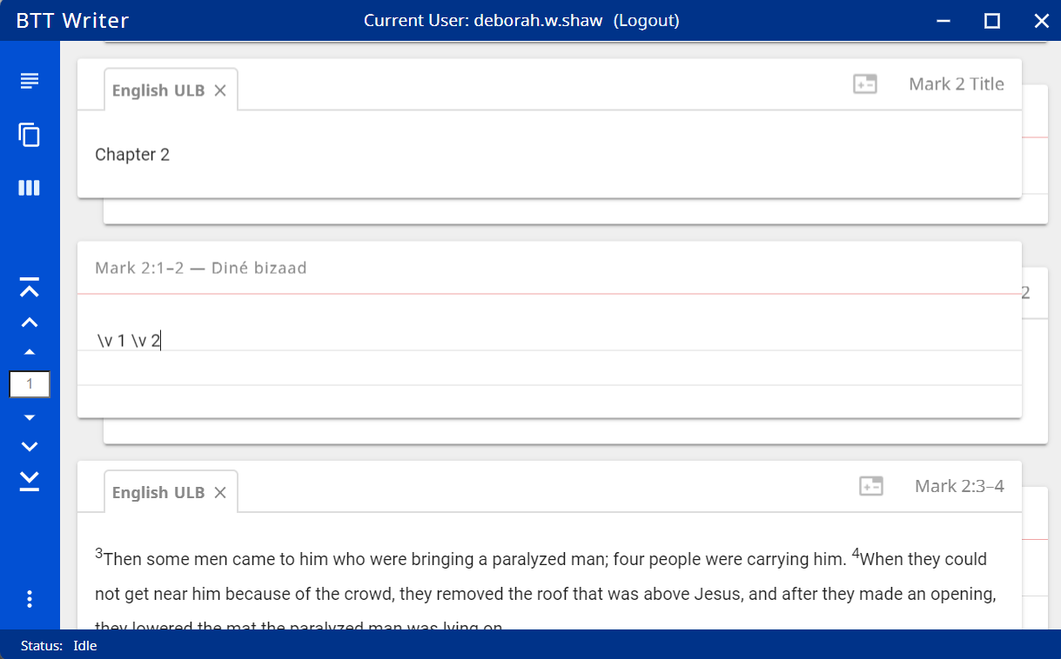
Step 4: Blind Draft (Blind Edit view)
Read the text to be
Translated
Then click on the back sheet for the drafting
Enter the translation in your heart language
Follow the same procedure for each section

Slide 30
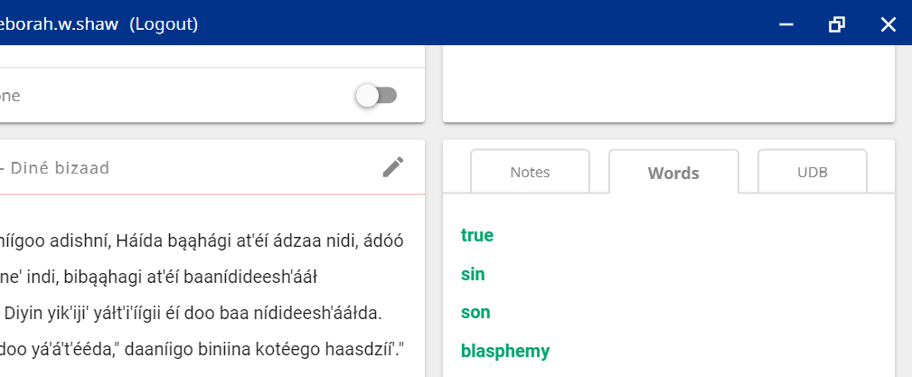
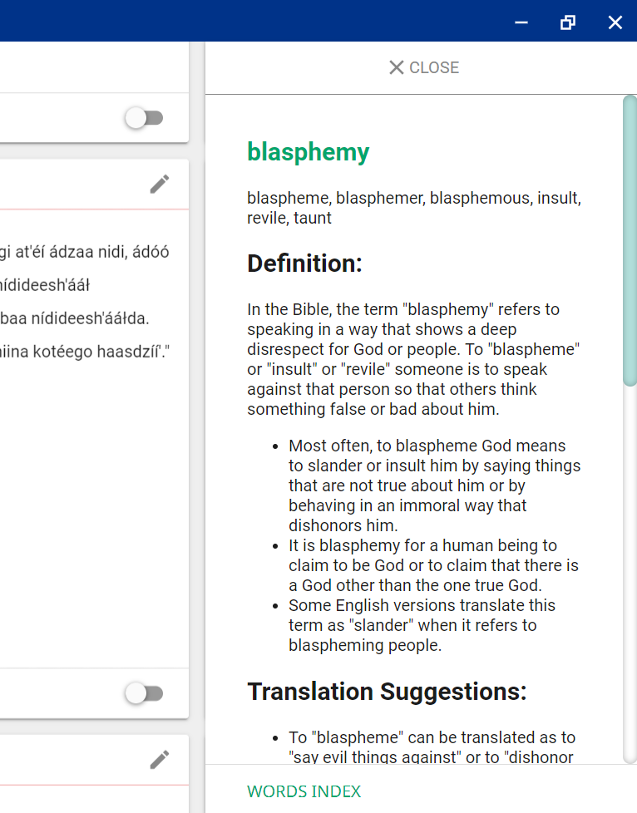
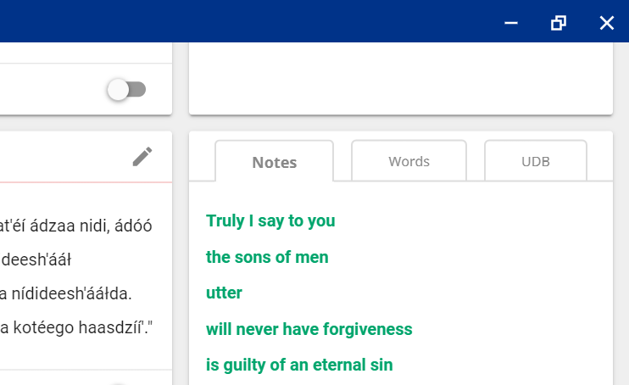
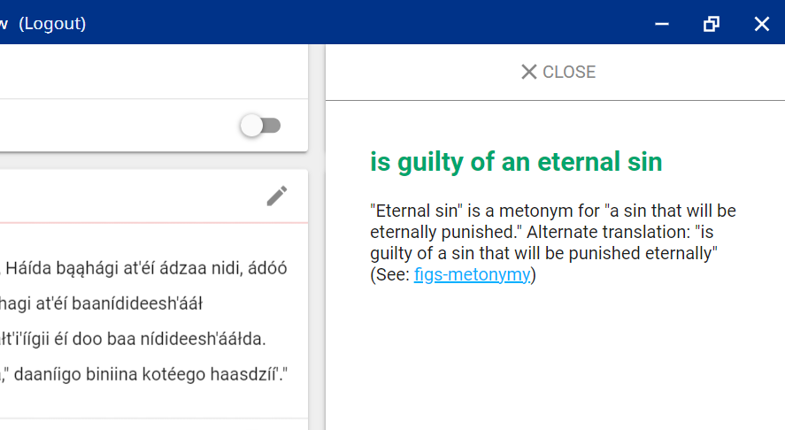
Step 5: Self-Check (Edit-Review view)
Checking Resources: Each resource has its own tab.
Click on an entry to open its article
.
Notes help clarify meaning
Some articles have links to other articles about language structure. These links open the Translation Manual in a separate window.

Slide 31
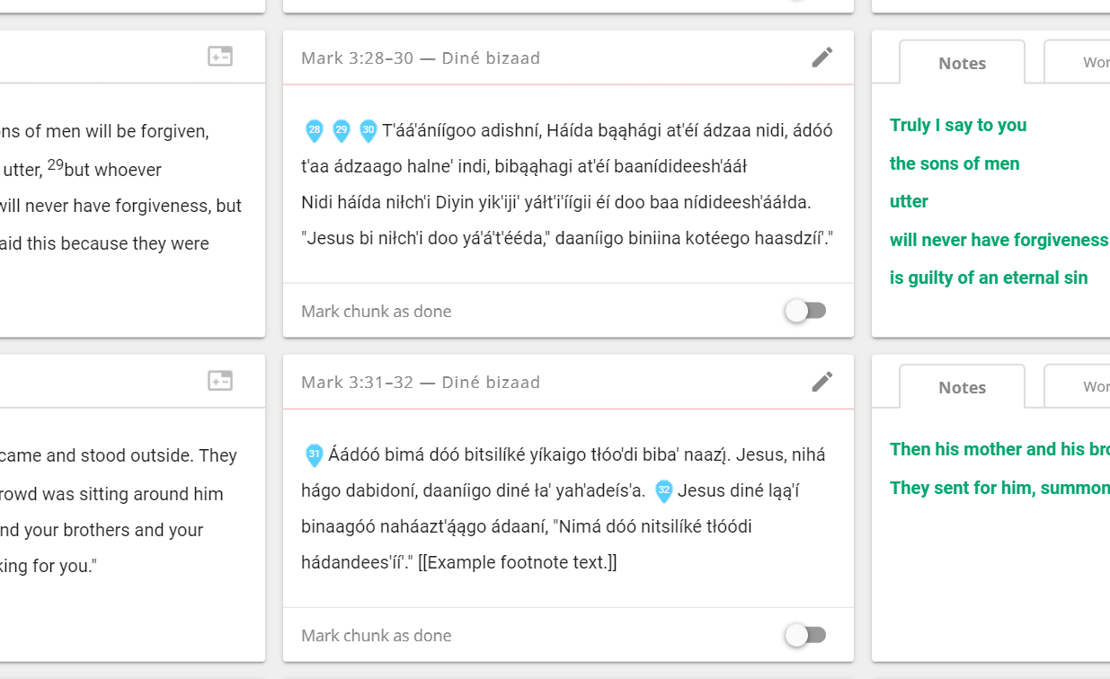
Placing Verse Markers
And Translating Footnotes
Your translation will show in the center column.
Click the “Edit” (pencil) icon to make changes.
Click and drag the verse markers to the first word of each verse.
Click and drag the verse markers to the first word of each verse.
When needed, add footnotes at the end of the verse. Enclose footnote text in double brackets.

Slide 32
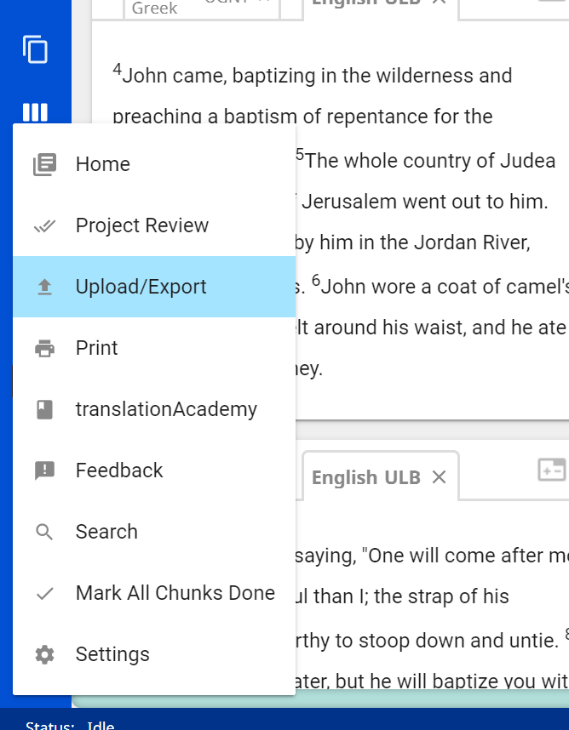
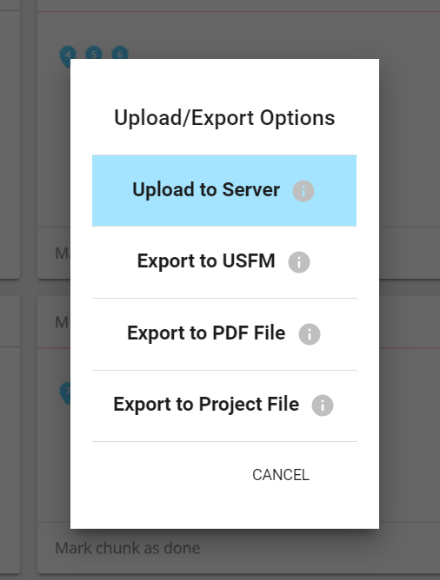
Uploading
Click on the menu and select “Upload/Export”
In the pop-up menu, click “Upload to Server”

Slide 33
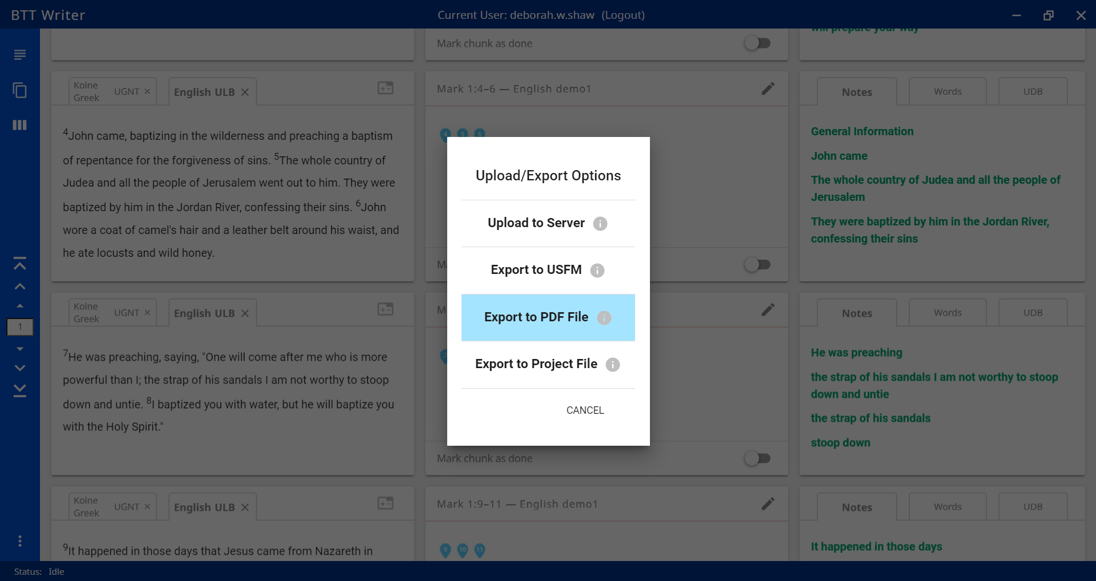
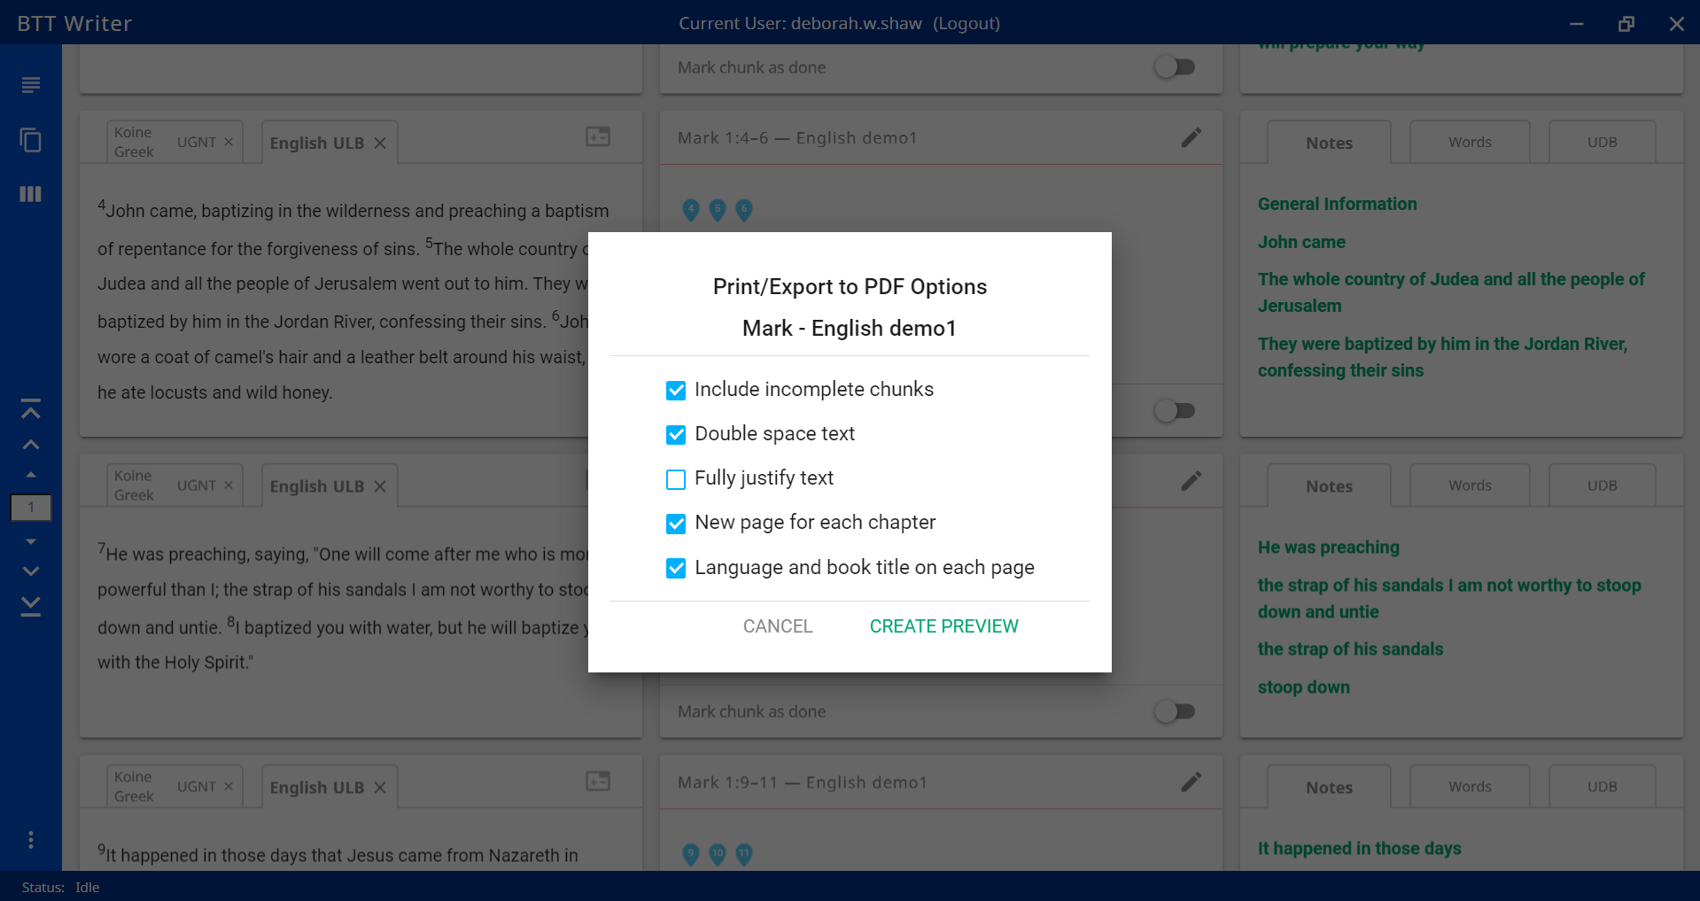
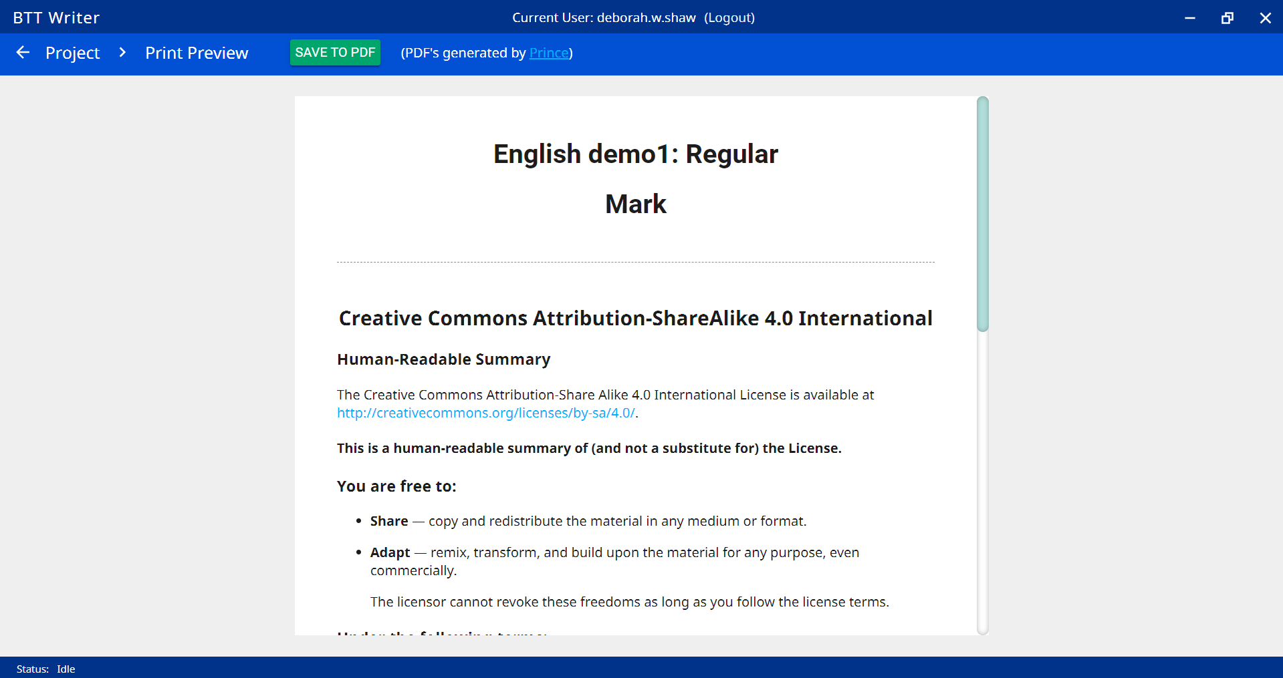
Exporting for Peer Check
Select “Export to PDF File”
Choose your settings. Double space is helpful for writing comments.
Look over the preview document. Then click “Save to PDF” and choose the file’s location.

Slide 34

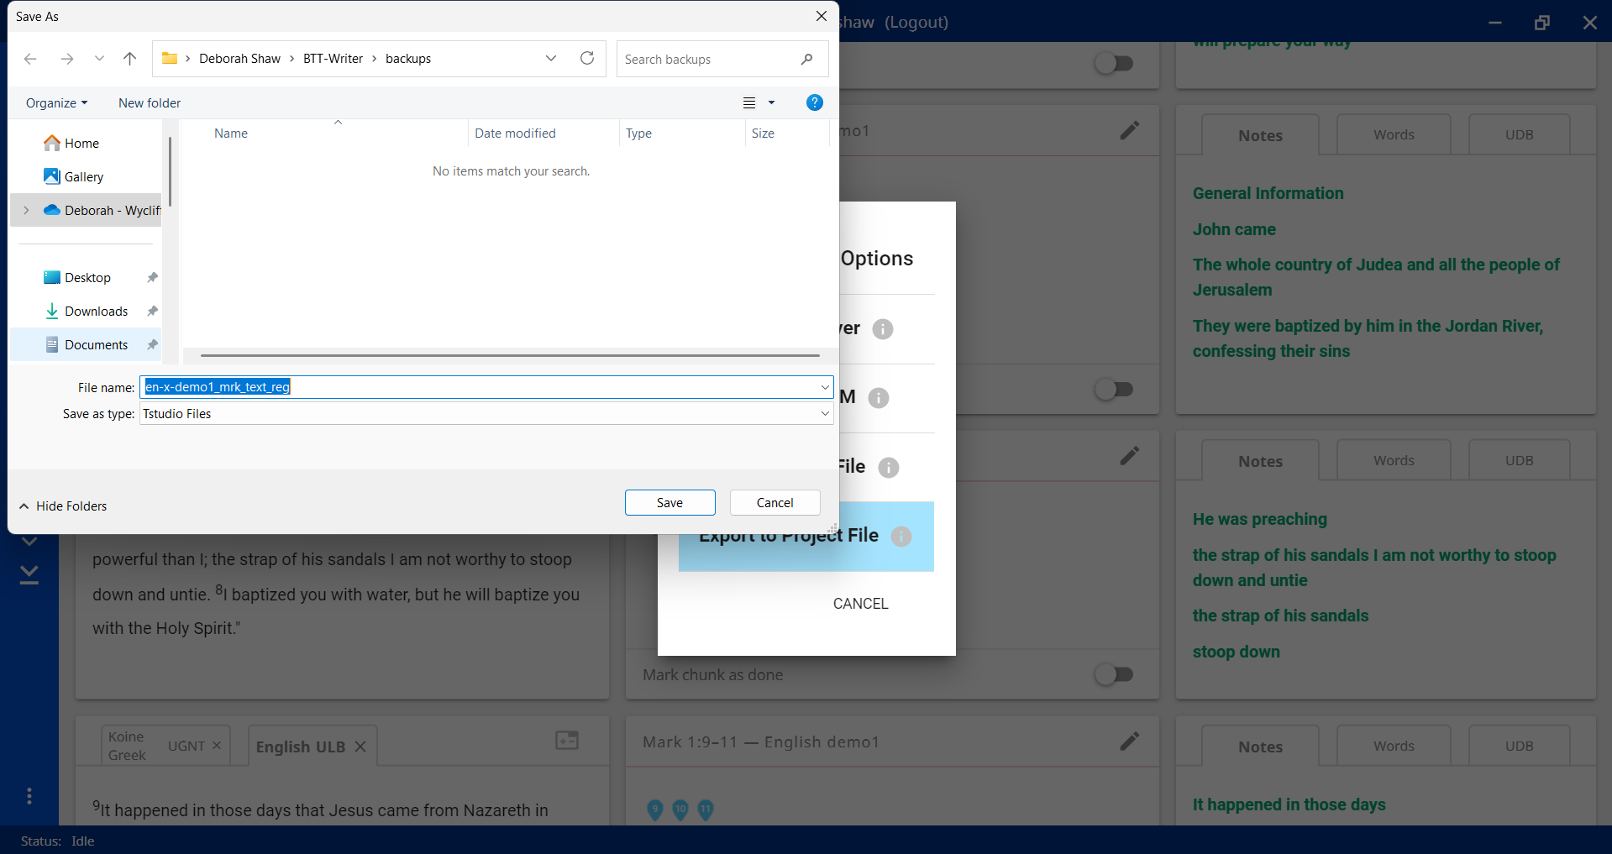
Exporting a Project File (usually for final upload)
Select “Export to Project File”
Choose file save location and click “Save”
Click on an entry to open its article

Slide 35
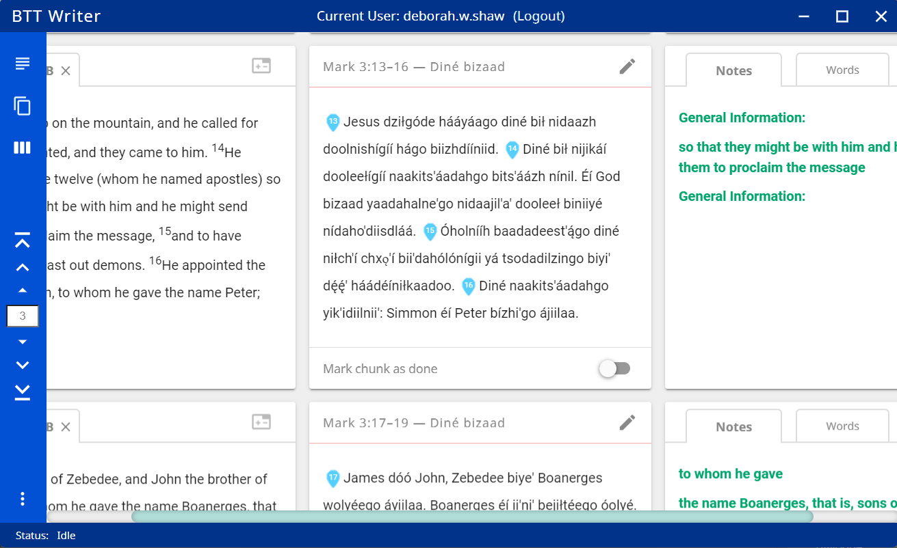

Marking chunk as done
After all 8 Steps, if everything is correct, click button to mark chunk as complete
In pop-up window, confirm that all 8 Steps have been completed

Slide 36


Importing a Project (for lost work or final upload)
From the Home screen, click the menu and select “Import”
Use “Import from Server” to recover work that had been uploaded
Use “Import Project File” to import work from a flash drive or other offline storage

Slide 37



Reviewing a Project
From the Home screen, click the “i” icon beside the project for the information window. Select the check-mark icon to Review.
Complete projects display check marks.
From the Home screen, click the “i” icon beside the project for the information window. Select the check-mark icon to Review.
Chunks that are incomplete show a “Review” button. Click “Review” to open and edit the chunk.

Slide 38

Listing Contributors
List the name or pseudonym.
Ensure the contributor has agreed to the Open-License Agreement, the Statement of Faith, and the Translation Guidelines.
When finished, click “Add Contributor”

